Slide 1

Intent Based Application
Advanced Network Architectures and Wireless Systems
Francesco Iemma
Yuri Mazzuoli
Giovanni Menghini

Slide 2
WHAT IS AN INTENT?
An intent is a request, done by a host, to have a link with another host, this link must tolerate link failures

Slide 3
01
02
04
PATH
RULES
RESPONSIVENESS
MODULE MAIN FUNCTIONALITIES
03
REST API
Compute the best path between two hosts
Installing rules in order to establish a path
Expose a REST API for request and delete an intent
Being responsive in case of link failure

Slide 4
FLOODLIGHT FORWARDING MODULE
The forwarding module “is the default module used for Floodlight's learning switch implementation. It inserts flows in switches that routes packets from the source to the destination".
The extended forwarding module extends the floodlight forwarding module and adds two functionalities:
Maintain an array list for storing the active intents
Packet-In message handling

Slide 5
INTENT LIFECYCLE
Creation
Activation
Expiration
Check for duplicate
New Timeout Task
Addition to intents DB
Allow Communications
Deny Communications
Delete intent from intents DB

Slide 6
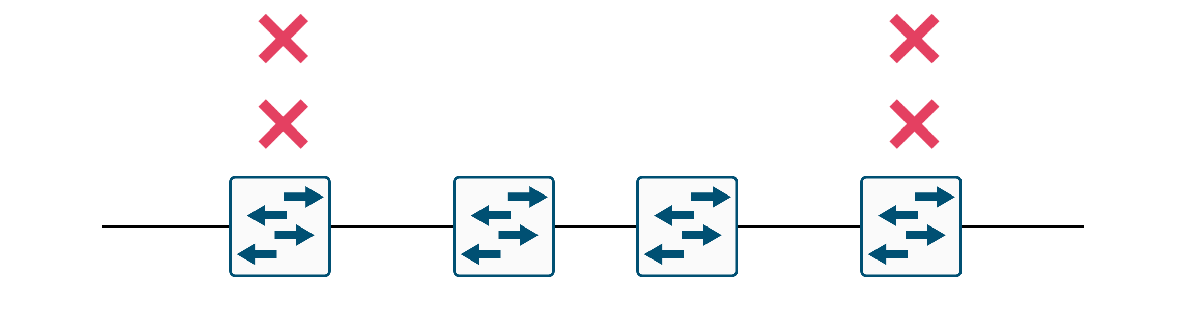
INTENT EXPIRATION (OR DELETION)
How to deny communications?
The controller installs rules on access switches
What about intent deletion?
For what concerns the deletion the operations are the same but we need also to delete the timeout

Slide 7

IPv4 & ARP MANAGEMENT
Is Source-Destination present in the intent database?
ALLOW
DENY
the packet to be forwarded and the route to be established by the superclass
the communication installing a temporary discard packet rule.

Slide 8


REST API
@Post( ″json″)
ADD NEW INTENT
host1_IP, host2_IP
timeout
@Post( ″json″)
DELETE ALL INTENTS
@Post( ″json″)
DELETE INTENT
host1_IP, host2_IP

Slide 9


REST API
@Get( ″json″)
GET INTENTS
List containing all existing intents
@Get( ″json″), @Post( ″json″)
MANAGE TIMEOUT
Read or Change deny timeout value

Slide 10


LINK FAILURE HANDLING
PREVENTIVE
REACTIVE
Double approach technique
Idle timeout for each rule:
If in this time no packets match it, the rule is deleted
Every time a link or a switch fails, involved path are recomputed and new rules are established

Slide 11


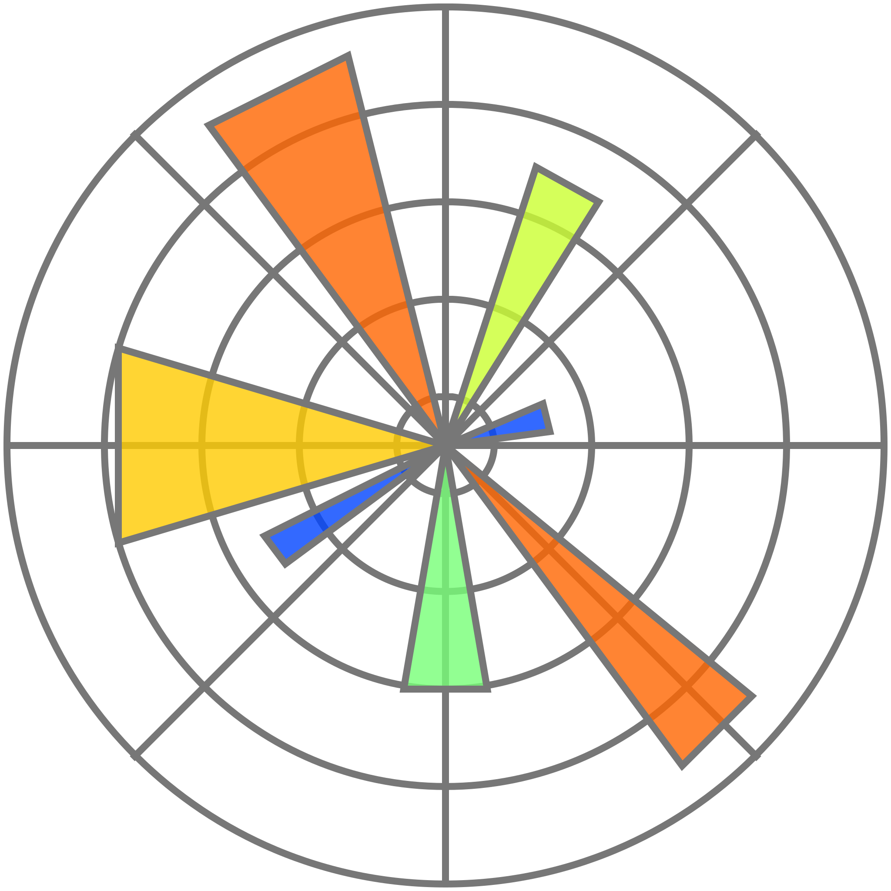

Testing
To test our system, we have used python 2 with requests, matplotlib and mininet modules

Slide 12
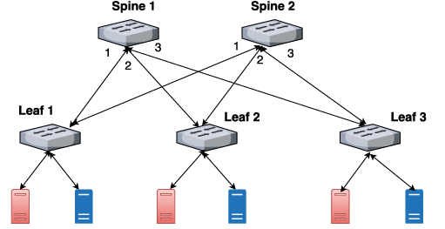

Link Failure Test
In this test we have tryed to manually generate a link failure, to demonstrate the capacity of our system to automatically recompute a functional path
2 Spines – 3 Leafs – 2 hosts per Leaf
Wireshark to monitoring link and control packet

Slide 13
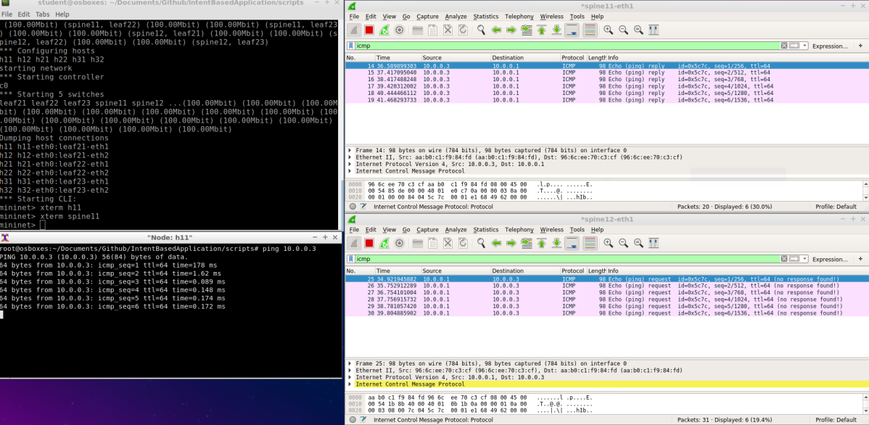
Link Failure Test
As picture shows, wireshark was put into 2 links:
Spine11-eth1, link between leaf 1 and spine 1
Spine12-eth0, link between leaf 1 and spine 2
Then 2 host in different leafs have been ping each other

Slide 14
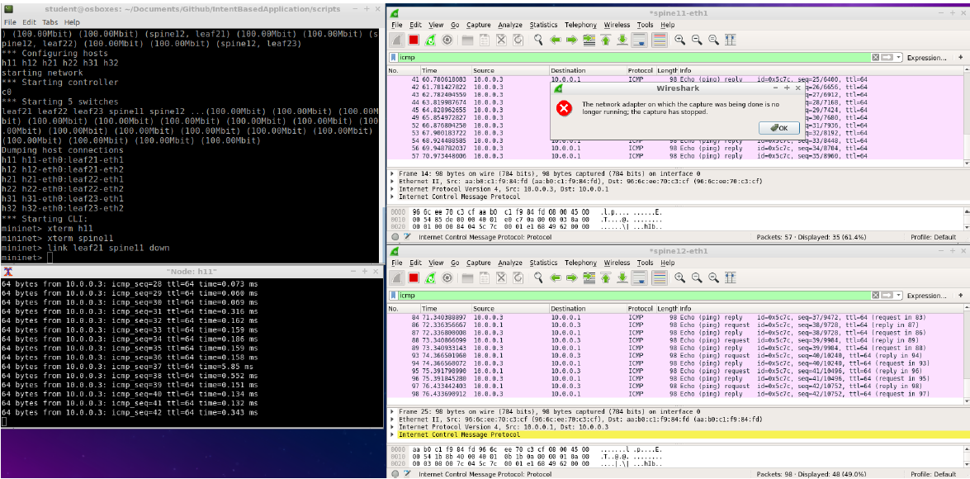
Link Failure Test
If we try to stop link Spine11-eth1 (first wireshark istance) we can see that it generates an error, but icmp packets are still exchanged between hosts, thanks to the new path recomputed by system (second wireshark instance)
High ping time at the failure moment

Slide 15

Ping Latency Test
This test was done to evaluate network performance. We have consider a scenario like before (2 spines, 3 lifes) but with 4 hosts connected to each leaf
Is established a random intent for each host
Is started a 10 - ping session for each host and round trip time of each packet is measured
Is measured also the number of DESTINATION HOST UNREACHABLE and DUPLICATE messages

Slide 16
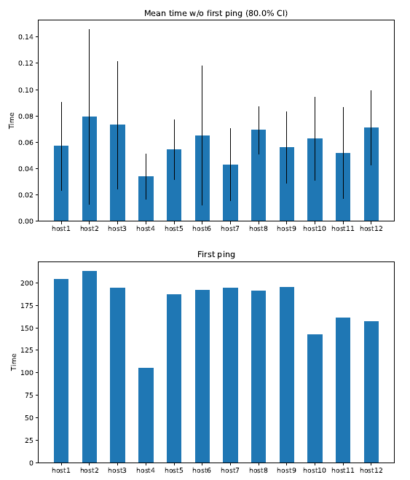
Ping Latency Test
Mean round trip time of each host without first packet
Round trip time of first packet of each host
First sent packet is normally more slower because it is processed by controller, triggering the route establishment

Slide 17
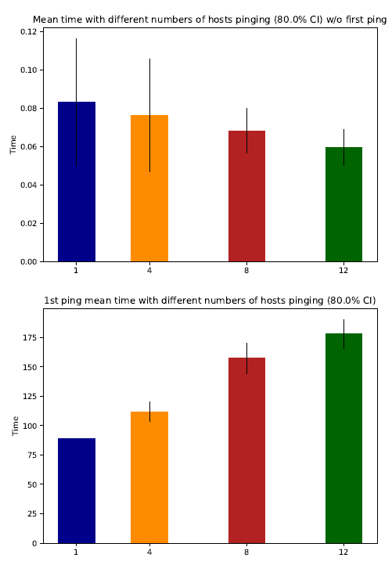
Ping Latency Test
Then these graphs shown the elasticity of our system, measuring mean round trip tipe of all packets with 1,4,8,12 hosts that pinging each other at the same time
Also at this time time for first packet and time about all other packets was splitted in 2 differents graphs

Slide 18
THANK YOU

